Slide 1
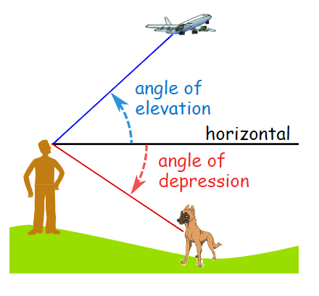
ANGLE OF ELEVATION & DEPRESSION
EQ: HOW DO I SOLVE FOR DIFFERENT ANGLES?

Slide 2
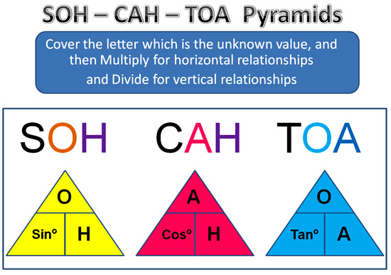
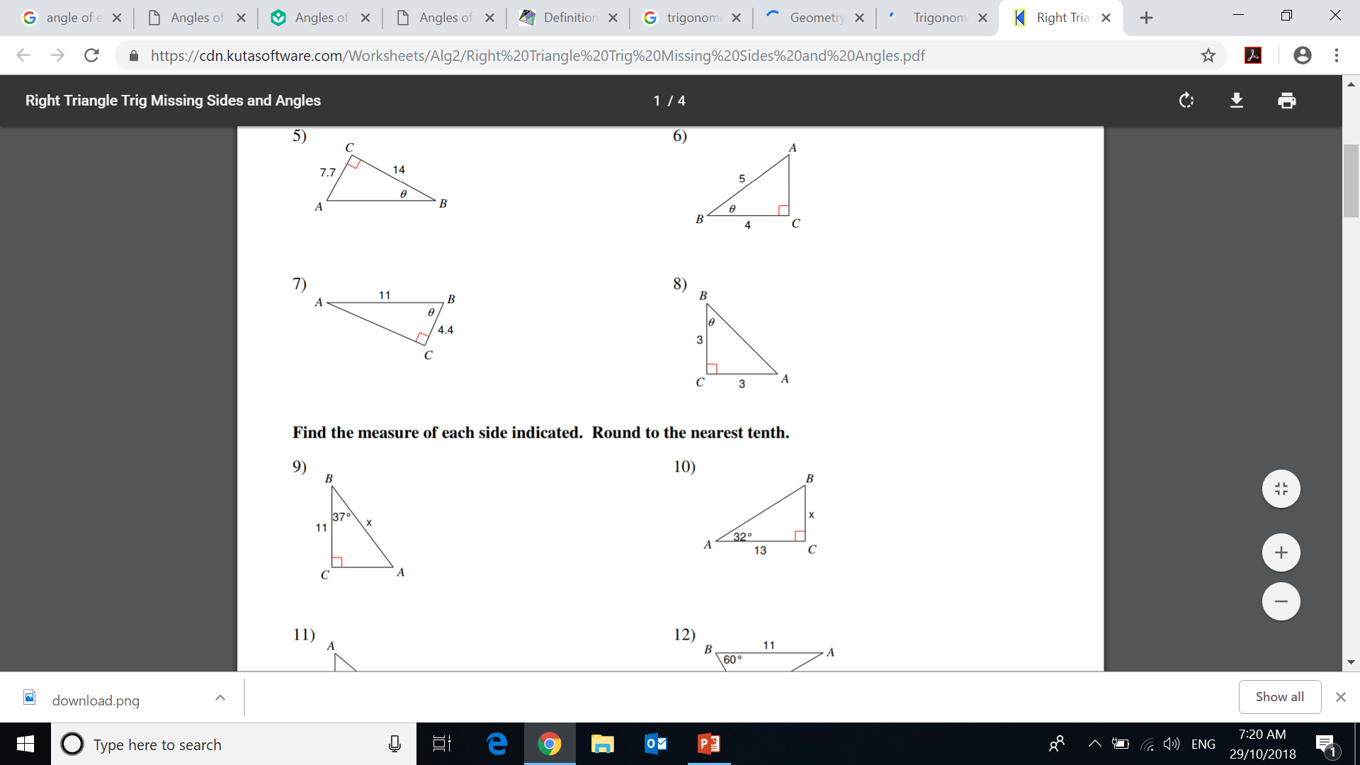
Have a go

Slide 3
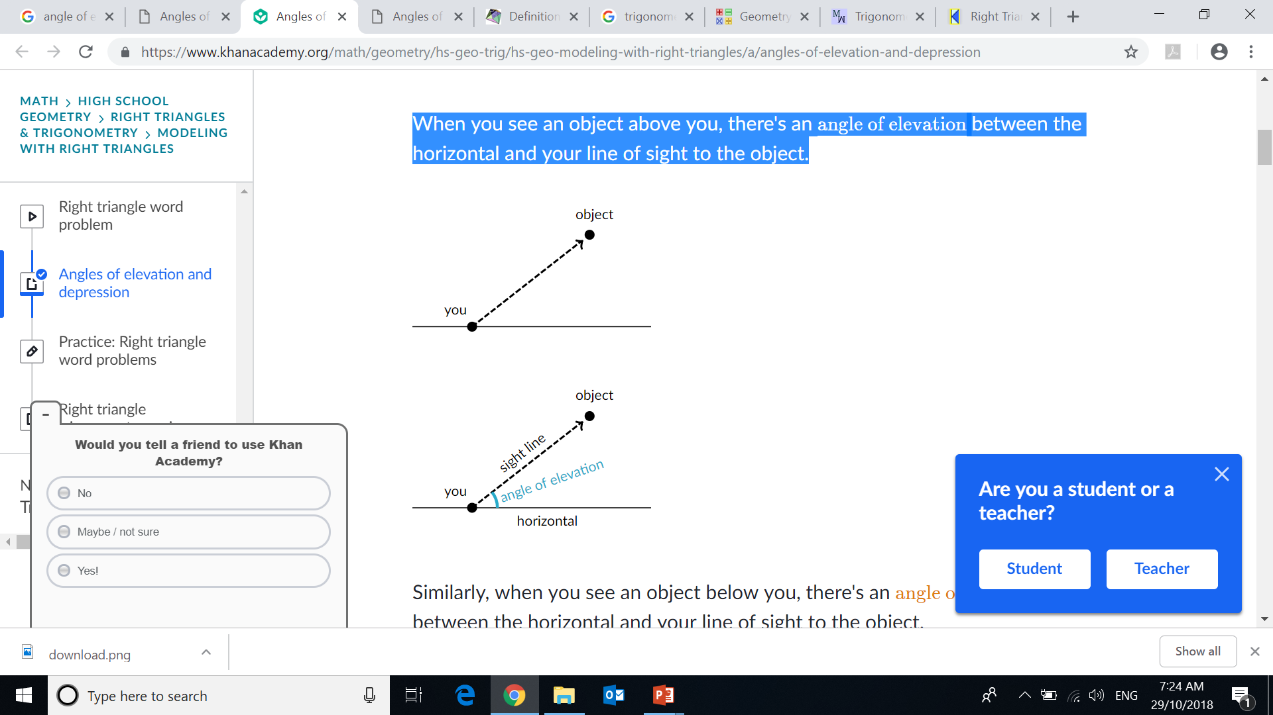
24
7
30
ANGLE OF ELEVATION & DEPRESSION
EQ: HOW DO I SOLVE FOR DIFFERENT ANGLES?
When you see an object above you, there's an angle of between the horizontal and your line of sight to the object.

Slide 4
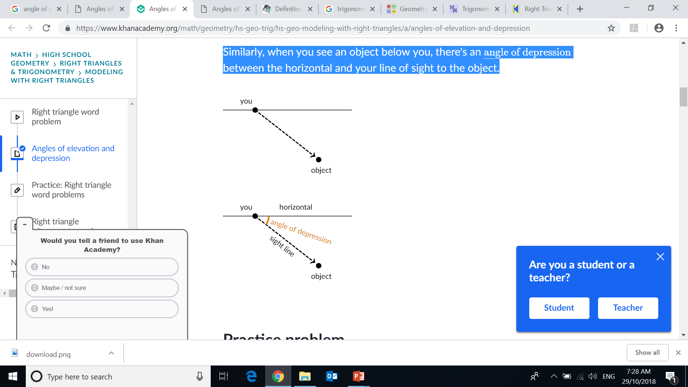
24
7
30
ANGLE OF ELEVATION & DEPRESSION
EQ: HOW DO I SOLVE FOR DIFFERENT ANGLES?
Similarly, when you see an object below you, there's an angle of depression between the horizontal and your line of sight to the object.

Slide 5
24
7
30
ANGLE OF ELEVATION & DEPRESSION
EQ: HOW DO I SOLVE FOR DIFFERENT ANGLES?
From the top of a vertical cliff 40 m high, the angle of depression of an object that is level with the base of the cliff is 34º.
How far is the object from the base of the cliff?

Slide 6
24
7
30
ANGLE OF ELEVATION & DEPRESSION
EQ: HOW DO I SOLVE FOR DIFFERENT ANGLES?
\
Your turn!!
Essentials book:
Page 174 & 175

